Slide 1
Digital Portfolio
STUDENT NAME: PRIYA.P
REGISTER NO AND NMID: 24131061802522042AND 49780A9C2537D5BB5B9471ACEC07261C
DEPARTMENT: ||-YEAR-BCA-B
COLLEGE: SHREE RAGAVENDHRA ARTS AND SCIENCE COLLEGE

Slide 2
PROJECT TITLE
Javascript framework and liabraries

Slide 3


AGENDA
Problem Statement
Project Overview
End Users
Tools and Technologies
Portfolio design and Layout
Features and Functionality
Results and Screenshots
Conclusion
Github Link
3/21/2024 Annual Review

Slide 4

PROBLEM STATEMENT
*“Modern web applications demand rich interactivity, high performance, and maintainable code. Traditional JavaScript, while powerful, becomes complex and hard to manage as application size grows. Developers face challenges like state management, DOM manipulation, and component reusability. This project explores how JavaScript frameworks and libraries (such as React, Angular, Vue, and jQuery) solve these challenges, streamline development, and improve user experience.”*

Slide 5

PROJECT OVERVIEW
This project focuses on exploring popular JavaScript frameworks and libraries that simplify and accelerate web development. It highlights the need for structured, efficient, and scalable code in modern web applications.
The project provides a comparative study of key frameworks and libraries such as React, Angular, Vue.js, and jQuery—analyzing their core features, use cases, advantages, and limitations.

Slide 6

WHO ARE THE END USERS?
Web developers:
They use these tools to build interactive, efficient, and maintainable web applications. Businesses and organisations:
They benefit from faster development cycles and better user experiences on their websites or web apps. Website visitors/users:
They experience improved performance, responsiveness, and richer interfaces powered by these frameworks.

Slide 7

TOOLS AND TECHNIQUES
Tools:
Code editors and IDEs.
Package managers.
Build tools.
Version control.
State management liabraries.
Techniques:
Component based architecture.
State management.
Virtual DOM.
Two way data binding.

Slide 8
POTFOLIO DESIGN AND LAYOUT
1.Home/Introduction Brief intro with animated typing effect (using React or Vue). Showcase key skills with smooth fade-ins or slides
2.About me Interactive timeline or card layout with hover animations. Use transitions for profile picture and skill badges. 3.Project section Grid or carousel of projects built with different frameworks (React, Angular, Vue). Each project card includes animated hover effects and modal pop-ups with details.
8

Slide 9
FEATURES AND FUNCTIONALITY
Component based: breaks UI into reusable, self-contained components.
Declarative programming:
Allow developer to describe the UI state,and the framework handles rendering
Efficient DOM manipulation:
Uses technoiques like virtual DOM to update only necessary part of the page

Slide 10
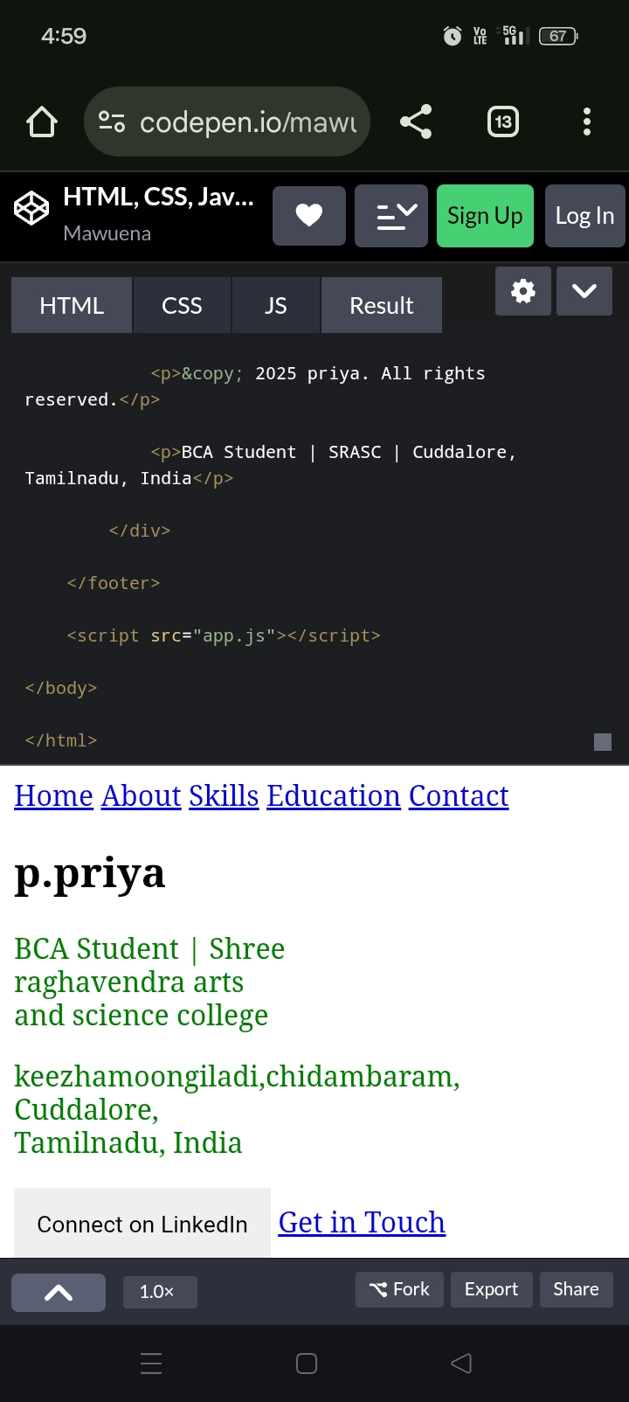

RESULTS AND SCREENSHOTS
3/21/2024 Annual Review
10

Slide 11
CONCLUSION
JavaScript frameworks and libraries simplify web development by making code more organized, efficient, and scalable. They help build dynamic, responsive, and user-friendly applications faster. Choosing the right tool depends on your project needs.
11

